Slide 1
Exploring finite-sample bias in propensity score weights
LUCY D’AGOSTINO MCGOWAN
&
ROBERT GREEVY, JR.
Notes:
We’ve shown these exciting new weighting methods that have dispelled myths about propensity score weighting. Weighting is dangerous when it comes to unmeasured confounding – it is true that it is theoretically possible for weighting to make things worse – if that unmeasured confounder has some correlation, weighting does better than covariate adjustment alone
Misconceptions:
Weighting has finite sample problems
It is inefficient
It makes unmeasured confounding worse
WRONG-WRONG relative to OLS – increase correlation between X2 X1 – one effect size, but what we vary is the correlation

Slide 2
Overview

Slide 3
Overview
Finite sample bias
Unmeasured confounding – the problem
Unmeasured confounding – a solution
1
2
3

Slide 4
treatment
control

Slide 5
trt
control
Notes:
The dark portion, the grey, are the propensity scores the top part of the mirrored histogram is the treated population and the bottom, the upside-down histogram is the control population. Then the green represents the weighted propensity scores for the treated and the blue is the weighted propensity scores for the controls.
Add a legend - maybe don't need all of the hatches

Slide 6
trt
control
151
Notes:
The dark portion, the grey, are the propensity scores the top part of the mirrored histogram is the treated population and the bottom, the upside-down histogram is the control population. Then the green represents the weighted propensity scores for the treated and the blue is the weighted propensity scores for the controls.
- Frequency counts for a sudo population based on the weights
_click_ This guy at the far end has a propensity score greater than .99, and therefore ends up accounting for 151 people in the sudo cohort

Slide 7
treatment
control
1
Notes:
Population: based on the table 1, the exposed and unexposed in the weighted Table 1 will look like each other, but they will look different than the overall cohort – they will look like if you had done a matched cohort (1:1 matching)
This one person now is only representing 1 person in the sudo cohort, meanwhile the 20 treated people right above are each account for 1/20th of a person in the sudo cohort

Slide 8
treatment
control
Notes:
Population: will look a lot like a Table 1 from a 1:1 matched trial, but shifts a bit to improve the variance

Slide 9
ATE
ATM
AT0

Slide 10
ATE
ATM
AT0

Slide 11
ATE
ATM
AT0

Slide 12
Finite-sample bias

Slide 13
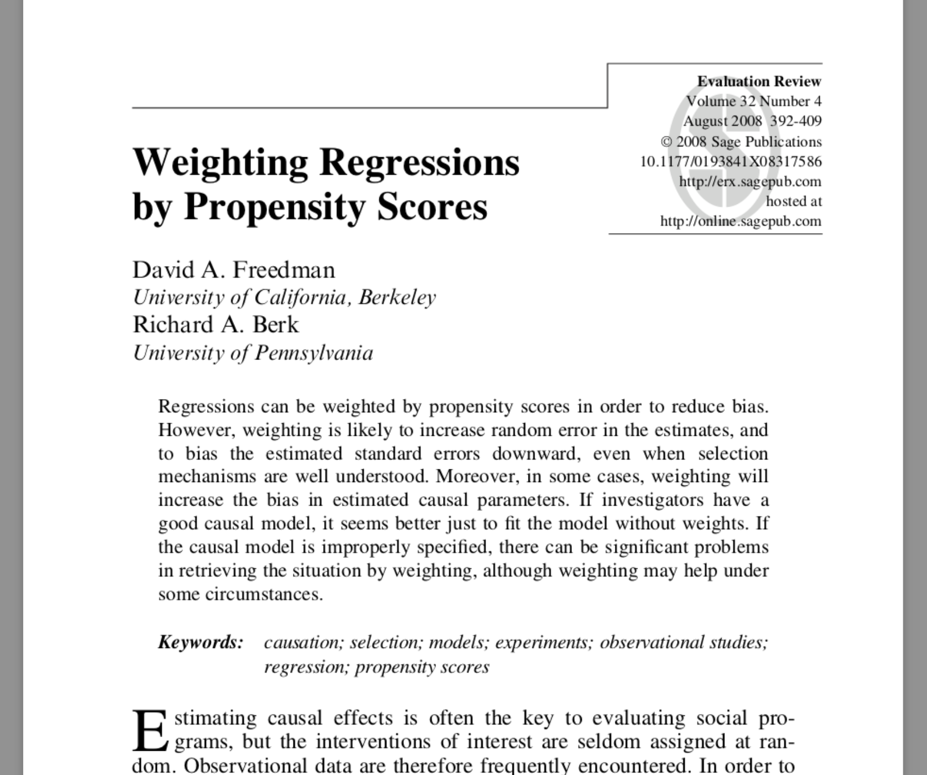
Notes:
* This is one of the seminal papers that made us think that weighting is inherently flawed. We’re going to show that it is not inherently flawed,

Slide 14
Doubly robust estimators
Fit a propensity score model
Fit two outcome models
Use these to estimate an average treatment effect
As long as one is correctly specified, your result will be consistent
Notes:
We’re going to focus on the example where what they do is the doubly robust estimator

Slide 15
Propensity score weighting method
The weights used in Freedman & Berk (2008) are estimating ATE
ATE weights can explode
Hypothesize that ATO and ATM weights will perform better
Notes:
These are known to be unstable because the weights can range from 0 to infinity

Slide 16
Fit a misspecified model
Allow the propensity score to be correct
The outcome model is missing a covariate
Notes:
They are intentionally creating a setup that is seemingly friendly to weighting to show that it fails even when it should have been working great

Slide 17
Freedman & Berk Simulation

Slide 18
x₁
x₂
z
y

Slide 19
1
x₁
x₂
0.25
2
0.75
1
z
1
y

Slide 20
1
x₁
x₂
0.25
2
0.75
1
z
1
y

Slide 21
1
x₁
x₂
0.25
2
0.75
1
z
1
y

Slide 22
1
x₁
x₂
0.25
2
0.75
1
z
1
y

Slide 23
1
x₁
x₂
0.25
2
0.75
1
z
1
y

Slide 24
Propensity score model
x₁
x₂
z

Slide 25
Outcome model
x₁
x₂
z
y

Slide 26
treatment
ctrl

Slide 27
n = 1000
Notes:
At n = 1000, Freedman and Berk report a bias of 0.13 and we replicate this, we observing a bias of 0.14. Even when n is 10,000, the result is still biased. So they of course were correct, these weights do lead to bias in finite samples.

Slide 28
Notes:
However it turns out to be less of a story about weighting in general, and more of a story about these particular weights.

Slide 30
Standard errors

Slide 31
Outcome model
x₁
x₂
z
y

Slide 32
Notes:
We replicate what Freedman and Berk show, that this difference in the true standard error of these estimates is 0.12.

Slide 33
Notes:
Correct-correct
Minimum variance unbiased estimator

Slide 35
Recap
Replicated the finite-sample bias seen by Freedman and Berk using the ATE weights
ATM and ATO weights had improved finite-sample properties
The variance for the ATO and ATM is preferable to that of the ATE

Slide 36
Unmeasured confounding the problem

Slide 37
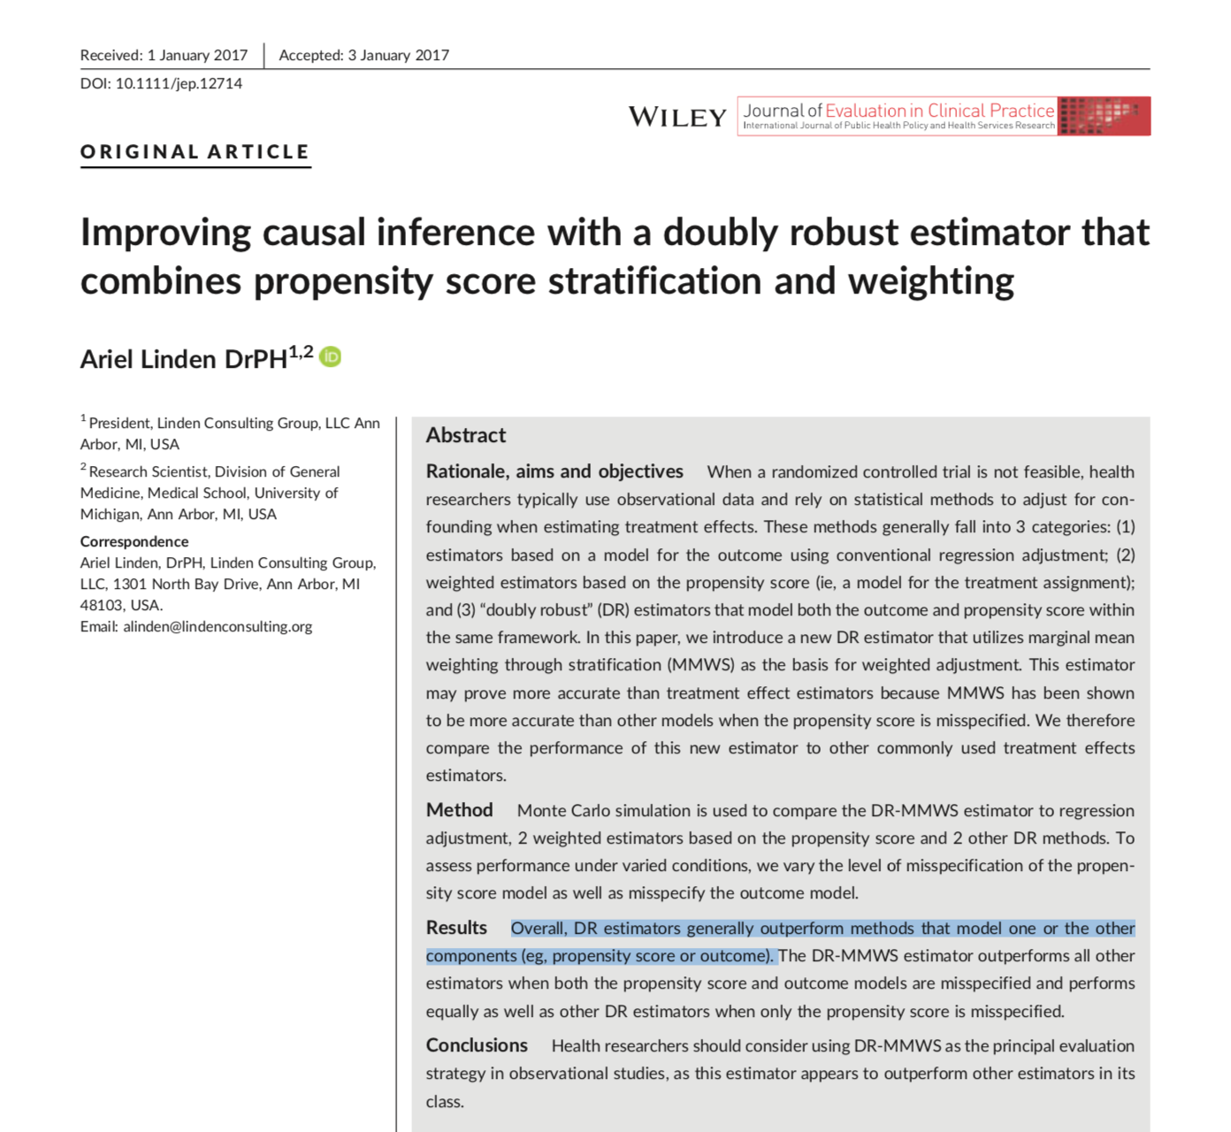
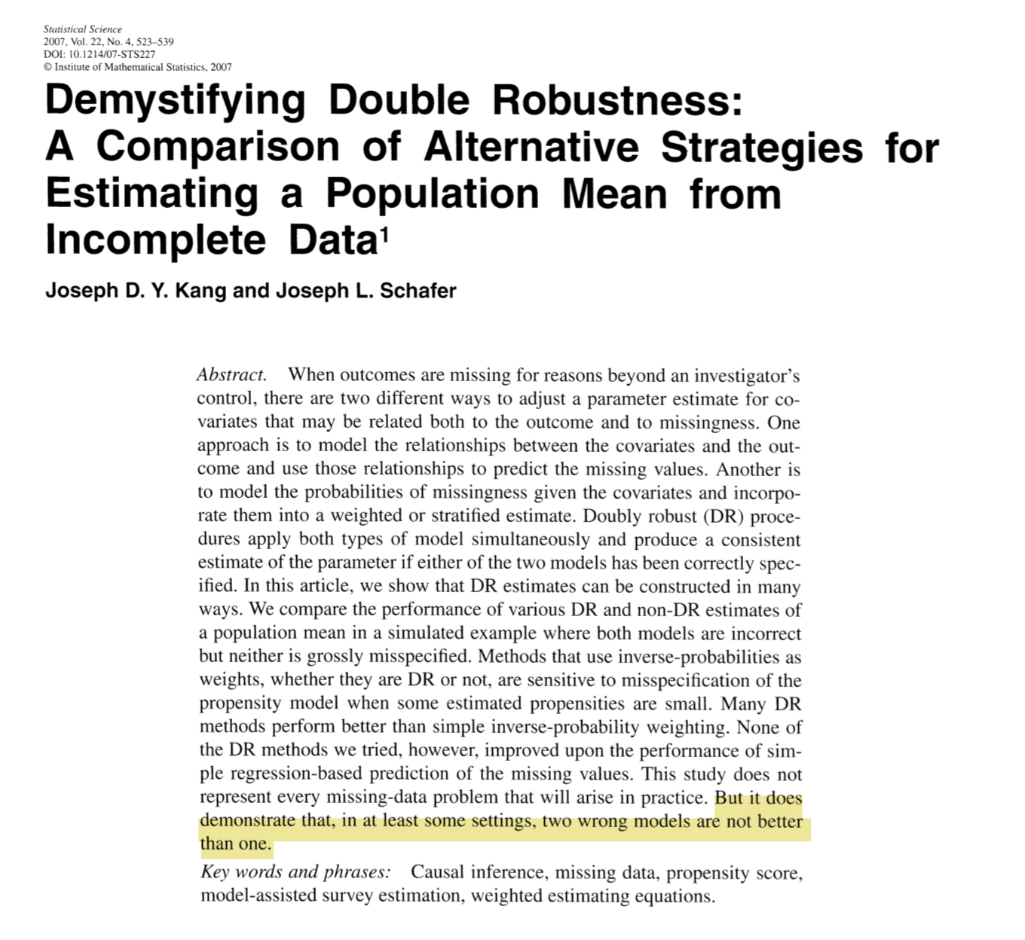

Slide 38
Propensity score model
x₁
x₂
z

Slide 39
Outcome model
x₁
x₂
z
y

Slide 41
Unmeasured confounding a solution

Slide 42
E-value
$$E−value=LB_{obs}+\sqrt{LB_{obs}×(LB_{obs}−1)}$$
Ding and VanderWeele (2017)
Notes:
Vanderweele and Ding’s E-value answers a similar question as this quantified sensitivity analysis, it is the point that minimizes the strength of association, on the risk ratio scale, that an unmeasured confounder would need to have with both the exposure and outcome, conditional on the measured covariates, to explain away an observed exposure-outcome association. Again this is certainly one way to look at the analysis, but can be difficult contextualize without more information.

Slide 43

Adjusted E-value
$$E−{value}_{adj}=\frac{LB_{obs}}{LB_{adj}}+\sqrt{\frac{LB_{obs}}{LB_{adj}}×\left(\frac{LB_{obs}}{LB_{adj}}−1\right)}$$
Notes:
we’ve used similar methodology to create an adjusted e-value, where we allow you to input the value you are trying to adjust to, rather than always setting the adjusted limiting bound to one. I will demonstrate soon how we can use this with our observed covariates

Slide 44
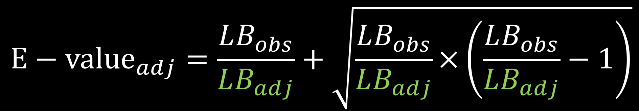
Adjusted E-value
$$E−{value}_{adj}=\frac{LB_{obs}}{LB_{adj}}+\sqrt{\frac{LB_{obs}}{LB_{adj}}×\left(\frac{LB_{obs}}{LB_{adj}}−1\right)}$$
Notes:
Rather than tipping to see where the lower bound crosses 1, we allow you to specify a value you’d like to tip to – this allows us calculate “observed e-values” for our measured covariates

Slide 45
Right Heart Catheterization Data
Connors et al (1996)
Notes:
This dataset is assessing the effectiveness of right heart catheterization (RHC) in the initial care of critically ill patients.
Publically available

Slide 46
Right Heart Catheterization data
We chose 20 covariates for demonstration purposes
demographics
comorbidities
physiological measurements
diagnosis categories
APACHE score
SUPPORT (probability of surviving 2 months)
DNR status on day 1
Connors et al (1996)
Notes:
We chose 20 covariates to include for demonstration purposes
Demographics
Comorbidities
Physiological measurements
Diagnosis categories
APACHE score
SUPPORT model estimate of the probability of surviving 2 months
DNR status on day 1

Slide 47
Right Heart Catheterization data
Fit a propensity score model
Use ATO weights
Fit weighted cox model for 30 day survival

Slide 48
Notes:
I’m going to spend a minute on this plot -- this is a plot we’ve come up with that we’re calling an ”observed bias plot” the light blue shaded region shows the confidence interval for the observed exposure – outcome effect with all covariates included in the analysis, so here the effect between RHC and 30 day survival, in our case it is about (1.11 to 1.37). The blue line down the center is the observed point estimate, in this case it is a hazard ratio around 1.24. Each black line is the exposure-outcome effect that would have been observed had the covariate indicated not been observed. For example this top one here _click_ is the observed effect between RHC and 30 day survival if we had not observed DNR status on day 1 _click_. The purple stars represent the “adjusted E-values” These represent what the E-value would be if the *only* unmeasured confounder that were missing is the one that is dropped. So this E-value here _click_ represents what the E-value would be if DNR status on day 1 were the only missing covariate. This gives some contextualization to the E-value, allowing you to imagine it in the context of your observed covariates

Slide 49
Notes:
We also include additional values at the bottom _click_ where we can observe what happens if we leave out groups of variables, such as Labs or physiological measurements. This begins to get at the question “what if we are missing a lot of unmeasured confounders”. We then also plot what an unmeasured confounder that would tip the analysis at the Lower Bound and at the point estimate would look like, along with the associated E-value.

Slide 50
Notes:
Given the observed lower bound of 1.11, the associated E-value is 1.46. Examining Observed bias plot we can add some context to this value. The only associated E-value close to this is that for DNR status on day 1. This implies that we would need to be missing an additional independent covariate akin to DNR status on day 1 in order to tip our analysis. Even dropping all physiological measurements would not reach an E-value great enough to tip this study to inconclusive.

Slide 51


Thank you!
@LucyStats http://bit.ly/LucyStatsENAR2018 lucymcgowan.com

